Slide 1
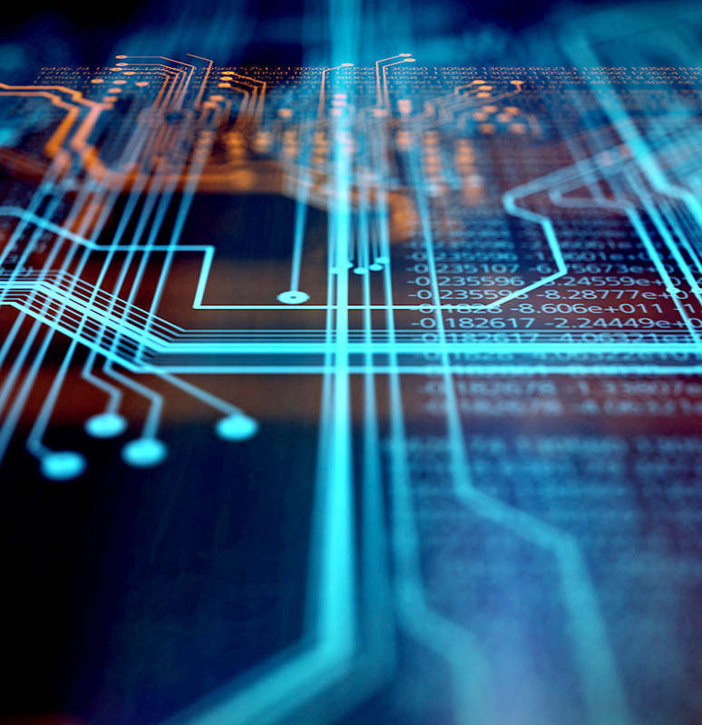
Design of Analog & Digital Data Acquisition System
Genesis Shadow Project
Unmesh Sameer Deshpande
Lakshmisha Gowda B
Asha N
Lakshmi Narayana S

Slide 2
Introduction

Slide 3
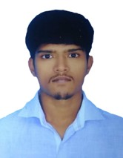
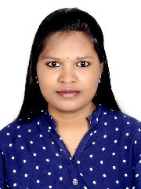
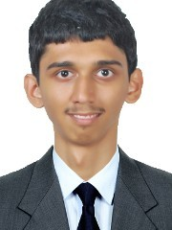
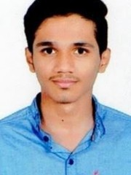
Project Highlights
Project Mentors
BU Mentor: Jagdish Prasad Sahu
GEA Mentor: Bhargav N
GENESIS Track Code: 2009BLRMED01
Unmesh Sameer Deshpande
PS Number : 99002485
Lakshmi Narayana S
PS Number : 99002536
Lakshmisha Gowda B
PS Number : 99002625
Asha N
PS Number : 99002646

Slide 4
Problem Statement
Design & Software Implementation of Analog & Digital Data Acquisition System

Slide 5
Objectives
Requirements specifications
Detailed design calculations and schematics
Firmware Design, Flow Chart, Pseudo Code or Python Code

Slide 6
Design

Slide 7
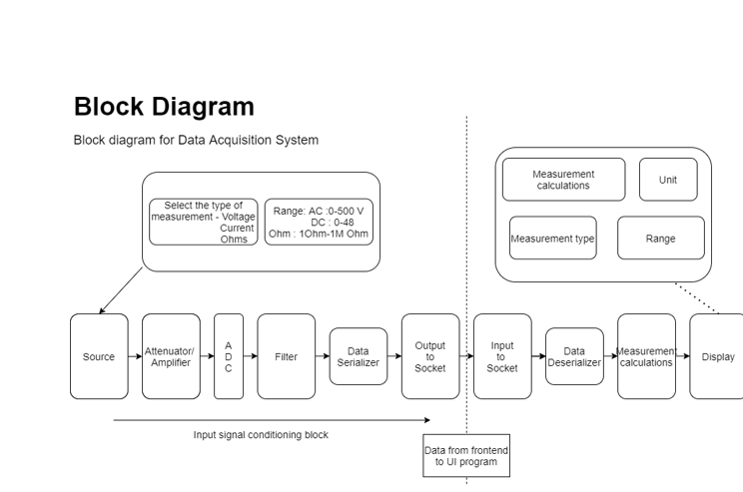
System Block Diagram

Slide 8
Implementation

Slide 9
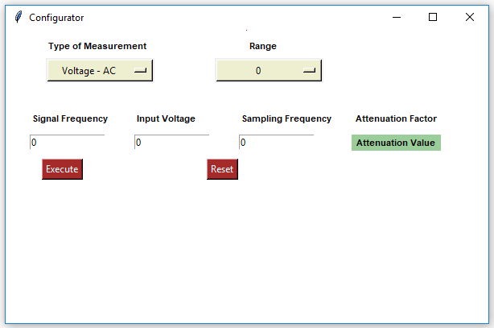
GUI for Configurator

Slide 10
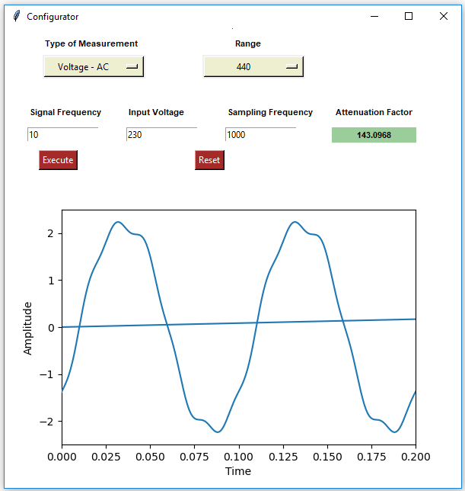
GUI for Configurator(Sine wave generator)

Slide 11
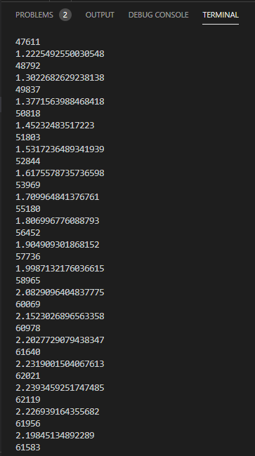
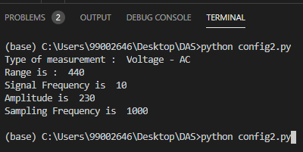
GUI for Configurator(Inputs and ADC output )

Slide 12
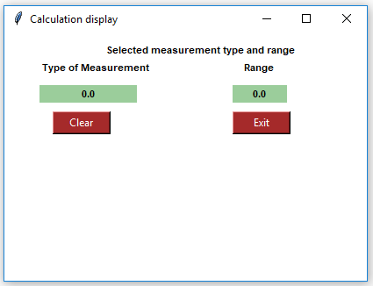
GUI for Display

Slide 13
Weekly Progress

Slide 14
Project Timeline
Completed
Active
Yet to start
Sl.No | Tasks | Week 1 | Week 2 | Week 3 | Week 4 | Week 5
1. | Understanding the System
2. | Requirement Specifications
3. | Block Diagram
4. | Designing the algorithm
5. | Implementation of Project.
6. | Validating of project
7. | Submission of project and Report

Slide 15
Task Summary
Completed
Active
Tasks during Week 1 and Week 2 (18-11-2020 to 28-11-2020)
Sl No | Tasks | Activity | Remarks
1 | Understanding the System | Exploring resources
 |  | Problem statement, Objectives
2 | Study on Concepts | Requirement Specification Document
 |  | Analog Filtering
 |  | Tkinter, Sockets
 |  | Signal Generator, Attenuator, ADC
3 | Documentation | Weekly report
 |  | Requirement Specification Document

Slide 16
Completed
Active
Tasks during Week 3 and Week 4(30-11-2020 TO 12-12-2020)
Sl No | Tasks | Activity | Remarks
1 | Design | Designing main block diagram
 |  | Designing Software and Hardware block diagram.
2 | Study on Concepts | Signal Generator, Attenuator, ADC
 |  | Learning about Matplotlib, Sockets programming, Real time sine wave generator
 |  | Digital filters
 |  | Understanding Mathematical equations of the signals.
3 | Implementation | Design GUI for Configurator and Display

Slide 17
Tasks during Week 3 and Week 4 (30-11-2020 to 12-12-2020)
Sl No | Tasks | Activity | Remarks
4 | Documentation | Block Diagram documentation, Daily and Weekly reports
5 | Simulating the system | Implementation of individual components of the project
6 | Designing the Algorithm And implementing | Integration of the individual components of the project

Slide 18
Thank you

